Slide 1
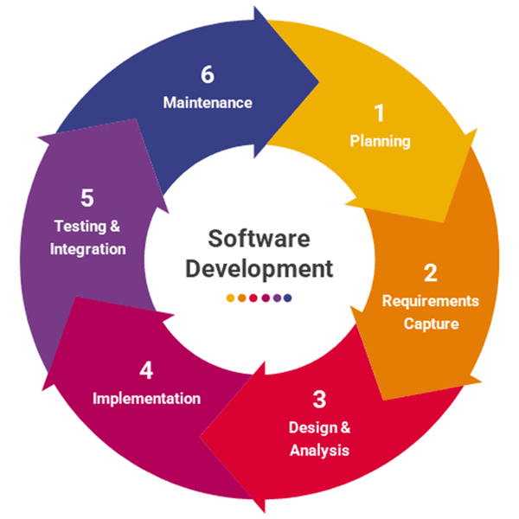
GLOSSARY
Reto 2b _
Mar 10th/ Name
PART 2

Slide 2
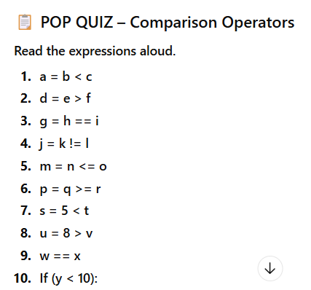

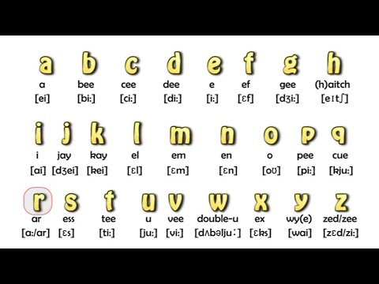
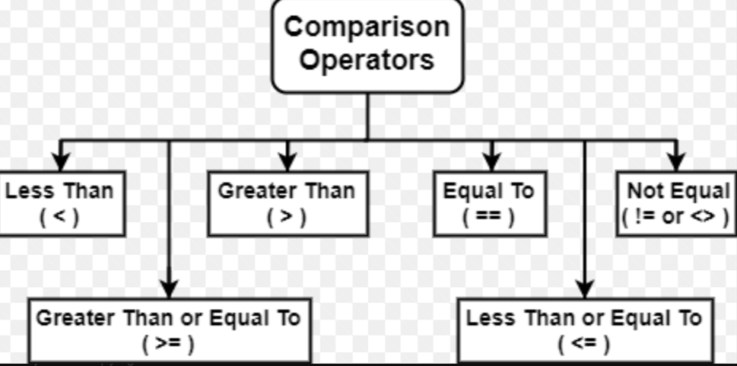
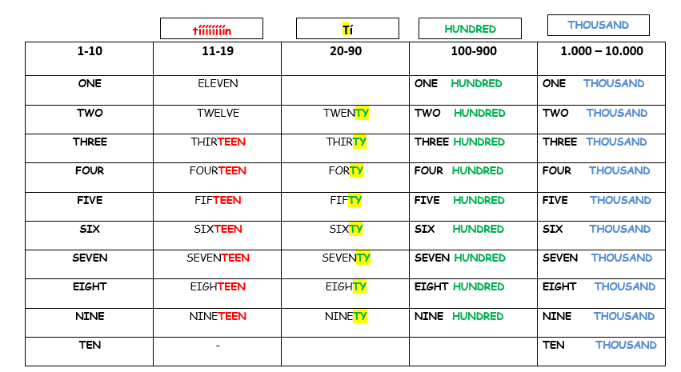
EQUATIONS
Dictation
python
DICTATION
Your Audio
Pronunciation Practice

